Slide 1
Identifying Subglacial Lakes
A Machine Learning Approach
Anastasia Horne, DSCI 403, Spring 2024

Slide 2
Outline
Overview
Datasets
BedMachine Antarctica
Other
Data Preprocessing
Visualize Lake Data
Scale the Data
Examine Features
Model Selection
Results and Evaluation
Future Work
Ethics
References

Slide 3
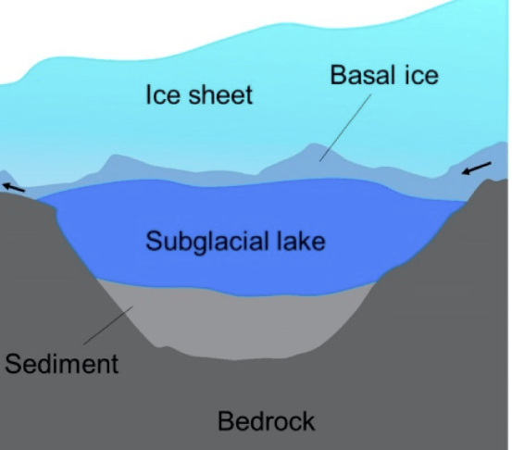
Overview
Primary Dataset: BedMachine Antarctica v3
Free, open source, dataset from NASA’s MEaSUREs program
Can be accessed using a free EarthAccess account
I am currently doing research in the Mines Glaciology Laboratory, so I am working with a dataset that relates to my research
GOAL:
Determine what hydrological features from the dataset help predict the existence of a subglacial lake
IDEA:
Given a list of confirmed subglacial lakes and a list of non-lakes, use a machine learning model to predict whether an area or point is a lake or not, given the features from BedMachine

Slide 4
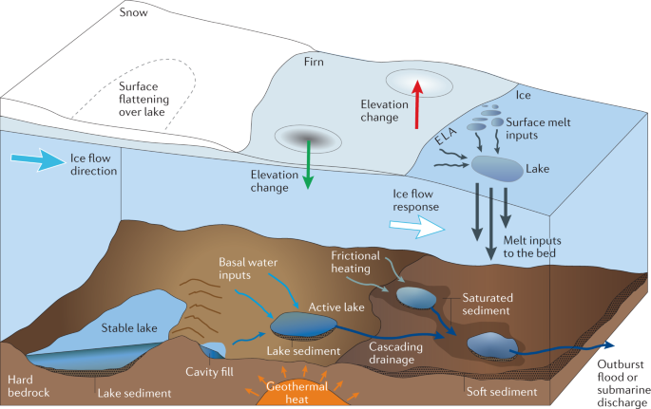
2.1 - BedMachine Antarctica
Features of Interest:
Bed - Represents the elevation of the sediment or bedrock beneath the ice/glacier.
Firn - Stage between snow and glacial ice where past snowfall is compacted down. The value in meters is the height of this layer.
Surface - Elevation of the ice surface in meters, which is the highest point of ice above the bedrock or sediment.
Thickness - The thickness of our ice in meters
X, y - Values are Antarctic Polar Stereographic coordinates of our features

Slide 5
2.2 - Other Datasets
Targets
Subglacial Lake CSV* -
Contains areas represented by polygons in Antarctic Polar Stereographic coordinates, along with names and citations of who discovered and published the lakes.
Non-subglacial Lake CSV* -
Contains Antarctic Polar Stereographic POINT(x, y) coordinates of non-subglacial lakes.
The lake points were chosen by taking a simple random sample of Antarctica with confirmed and suspected lake areas removed.
Grounding Line -
Antarctica has land ice and sea ice, subglacial lakes only exist under land ice so we need to limit/clip our BedMachine values to the grounding line.
*Obtained from code written by my research advisor, Wilson Sauthoff

Slide 6
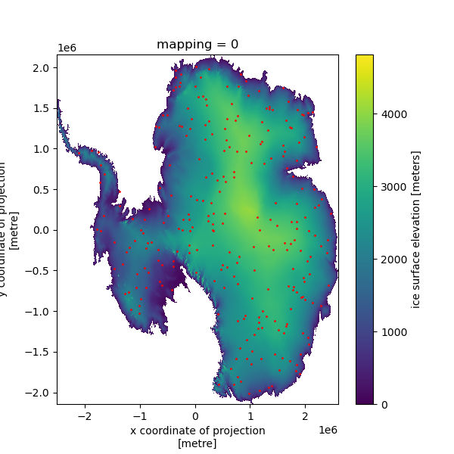
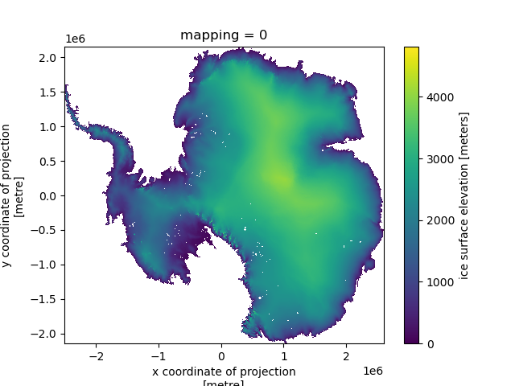
3.1- Visualize Lake Data
Non-Lake Points
Lake Points

Slide 7
3.2 - Scale the Data
After applying a standard scaler transformation, we get the new range for our features.
Looking at the features we see each has a very different range.
Feature | Min Value | Max Value
Firn | 0 | 38.092
Ice Surface Elevation | 68.641 | 3967.425
Ice Thickness | 0 | 4126.224
Bed Elevation | -2394.072 | 2527.325
Feature | Min Value | Max Value
Firn | -3.380 | 2.335
Ice Surface Elevation | -1.837 | 1.986
Ice Thickness | -2.334 | 2.072
Bed Elevation | -2.801 | 3.614

Slide 8
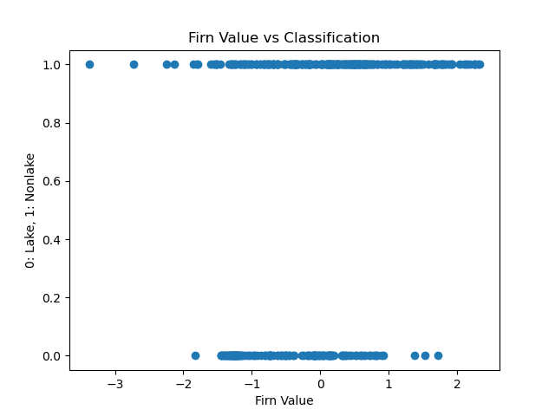
3.3 - Examine Features (1)
Each horizontal line represents a lake (0 value) and nonlake (1 value).
There is still overlap between lakes and non-lakes, however the range of values for non-lakes is larger than the range for lakes.
Firn value might be an indicator of a subglacial lake, but it is clear that firn value alone cannot accurately classify a lake.

Slide 9
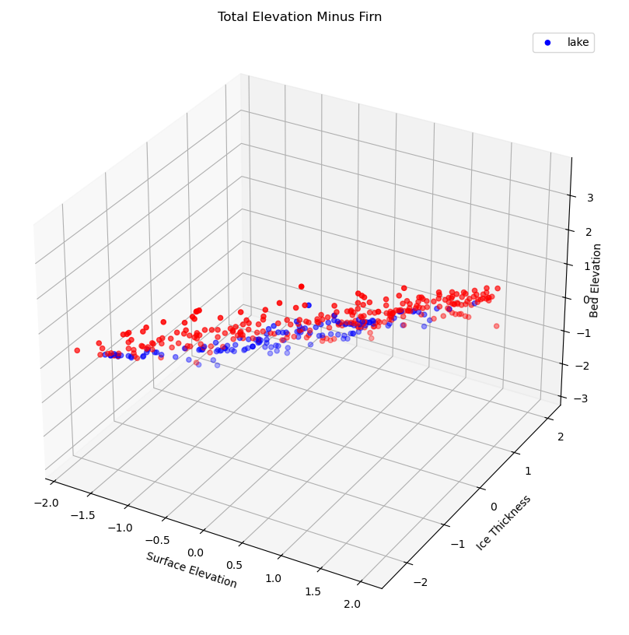
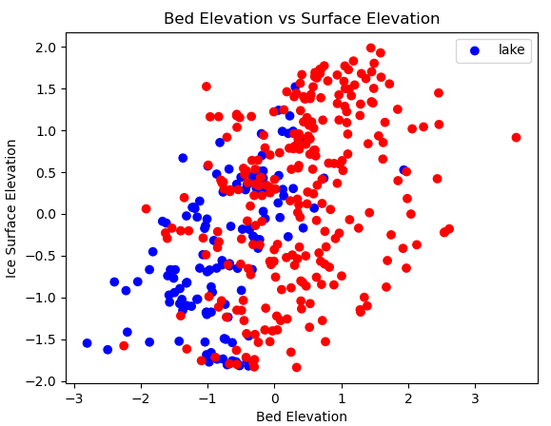
3.3 - Examine Features (2)
Both show a linear relationship between the feature values.
Some overlap between lakes and non-lakes, but there seems to be two separate trend lines for lakes and non-lakes.

Slide 10
Model Selection
Model (lake) | Precision | Recall | f1-score | Accuracy
KNN | 0.65 | 0.89 | 0.75 | 0.78
SVM | 0.68 | 0.43 | 0.53 | 0.71
LR | 0.75 | 0.55 | 0.63 | 0.76
The goal of any of model is to accurately classify a point as a subglacial lake or not.
We will use a supervised classification machine learning algorithm.
Models Considered:
K-Neighbors Classifier, Support-Vector Machines (SVM), and Logistic Regression (LR).
Data was separated so 30% is removed for testing, and 70% is reserved for training the model.
KNN has the highest recall for lakes and a reasonable recall for non-lakes, and it has the highest accuracy score. Thus we will use K-Neighbors Classifier.
Model (non) | Precision | Recall | f1-score | Accuracy
KNN | 0.91 | 0.72 | 0.80 | 0.78
SVM | 0.72 | 0.88 | 0.79 | 0.71
LR | 0.77 | 0.89 | 0.82 | 0.76

Slide 11
Results and Evaluation
Precision -
Lake score is fairly low at 0.65 due to 21 false positives.
Nonlake score is very high at 0.91, meaning we have less false positives for non-lakes.
Recall -
Lake score is very high at 0.89, due to 5 false negatives.
Nonlake score was lower as there were 21 false negatives.
F1-Score -
Lakes and nonlakes score are similar and fairly large.
Thus our targets are balanced between false negatives and false positives.
Confusion Matrix for KNN Model |  | Predicted Label
 |  | Lake | Nonlake
True Label | Lake | 39 | 5
 | Nonlake | 21 | 53
Model | Precision | Recall | f1-score | Accuracy
Lake | 0.65 | 0.89 | 0.75 | 0.78
Non-Lake | 0.91 | 0.72 | 0.80 | 0.78

Slide 12
Future Work
Expand the features -
Ice-hydrology of Antarctica is very complex, with many features beyond what this project uses.
Try more complex ML algorithms -
Random Forests
Neural Networks
Expand model to classify a subglacial lake as either active or inactive
It would be necessary to use more data, and some that shows feature changes over time.

Slide 13
Ethics
The faster glaciers flow, the quicker they melt, and their flow rate is highly dependent on their subglacial hydrology
Knowing more about subglacial lakes would allow us to know more about glacial flow
Climate change -
If the glaciers in Antarctica and Greenland were to all melt, sea level would rise by approximately 210 feet
Coastal Erosion
Increase in storm surges
Chemical composition of the water can give information on ancient climate and atmospheric conditions
Antarctica is very cold, thus it preserves ancient information
Lakes contain ancient microorganisms
This project does not have any clear ethical or societal impacts because it is located in an area of the world where very few humans reside.
There are two main impacts we can consider. The impact subglacial lakes have on climate change, and what we can do with knowing where these subglacial lakes are.

Slide 14
References
Depoorter, Mathieu A; Bamber, Jonathan L; Griggs, Jennifer; Lenaerts, Jan T M; Ligtenberg, Stefan R M; van den Broeke, Michiel R; Moholdt, Geir (2013): Antarctic masks (ice-shelves, ice-sheet, and islands), link to shape file. PANGAEA, https://doi.org/10.1594/PANGAEA.819147,
Livingstone, S.J., Li, Y., Rutishauser, A. et al. Subglacial lakes and their changing role in a warming climate. Nat Rev Earth Environ 3, 106–124 (2022). https://doi.org/10.1038/s43017-021-00246-9
Morlighem, M., Williams, C. N., Rignot, E., An, L., Arndt, J. E., Bamber, J. L., ... Zinglersen, K. B. (2017). BedMachine v3: Complete bed topography and ocean bathymetry mapping of Greenland from multibeam echo sounding combined with mass conservation. Geophysical Research Letters, 44, 11,051–11,061. https://doi.org/10.1002/2017GL074954
Sauthoff, Wilson. “Multi-mission altimetry of variable Antarctic active subglacial lake geometries and causal inference networks to inform geostatistics-based subglacial water modeling”. 2022.
Gong D, Fan X, Li Y, Li B, Zhang N, Gromig R, Smith EC, Dummann W, Berger S, Eisen O, et al. Coring of Antarctic Subglacial Sediments. Journal of Marine Science and Engineering. 2019; 7(6):194. https://doi.org/10.3390/jmse7060194

